Slide 1


Slide 2
Agenda:
1. What is Measurement?
2. Direct Measures.
3. Indirect Measures.
4. Subject (Soft) Measures.
5. What is Data?.
6. Data Presentation.

Slide 3
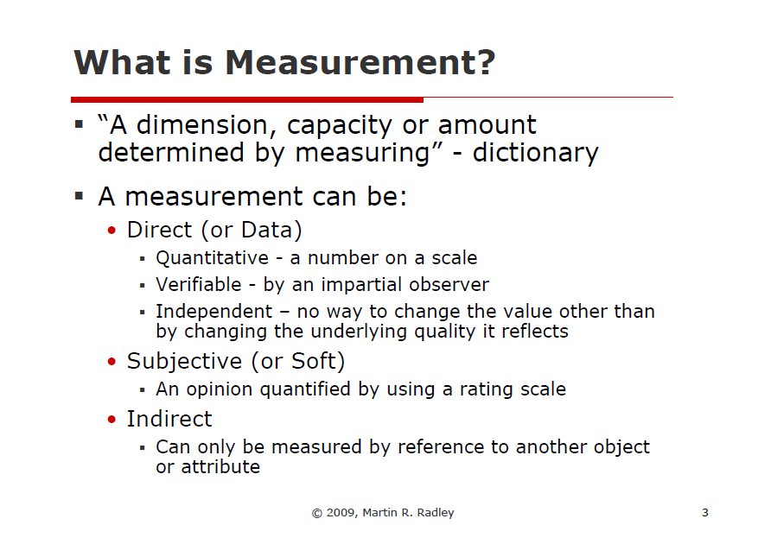
Notes:
Thu’

Slide 4
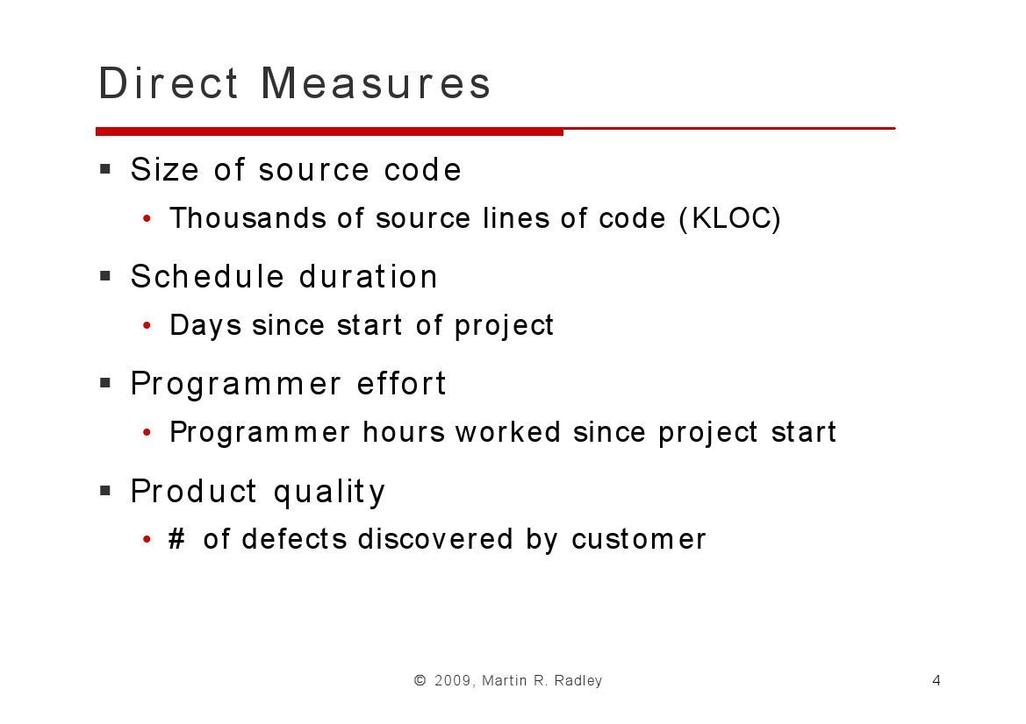
Notes:
Dao

Slide 5
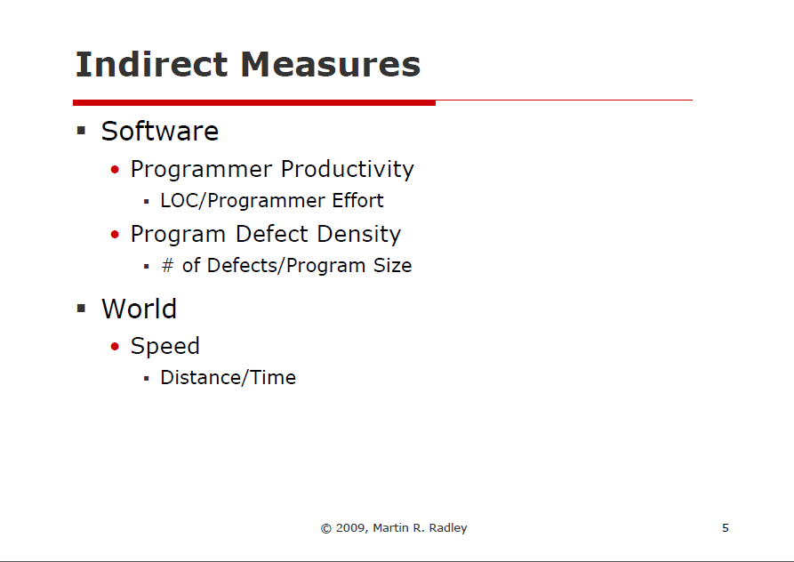
Notes:
Phu

Slide 6
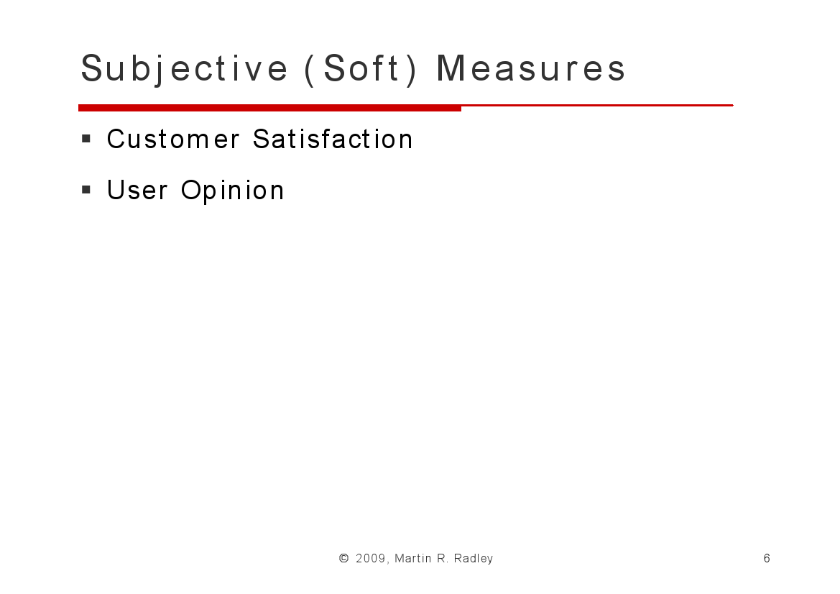
Notes:
Khang

Slide 7
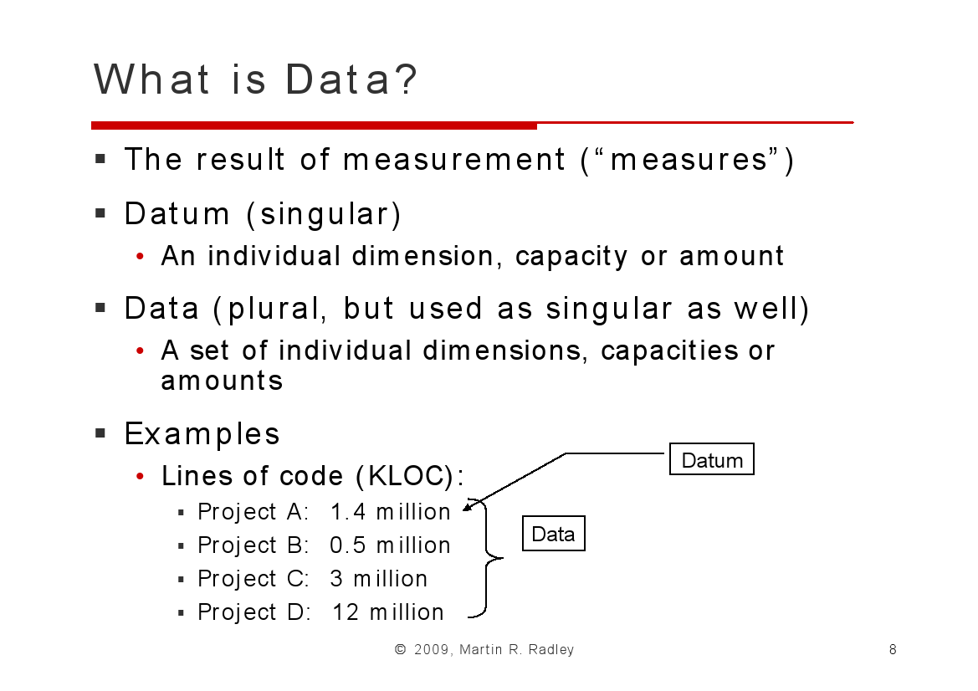
Notes:
Chau

Slide 8
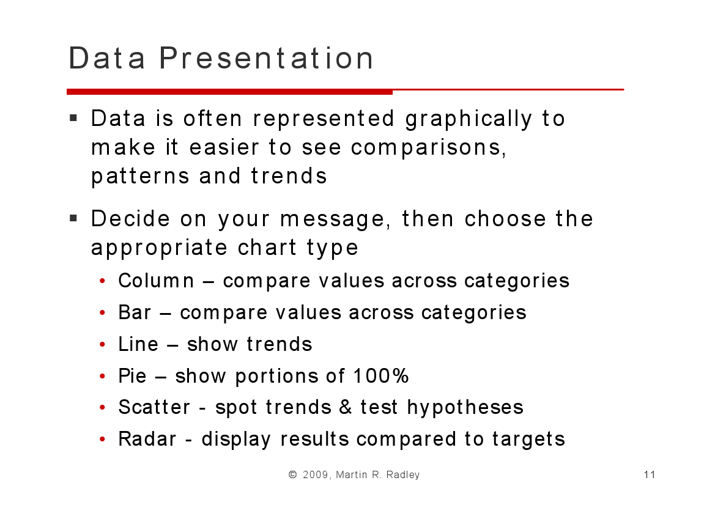
Notes:
Thai Anh

